Slide 1
Radiation
Atmospheric Sciences 101
Winter 2020

Slide 2
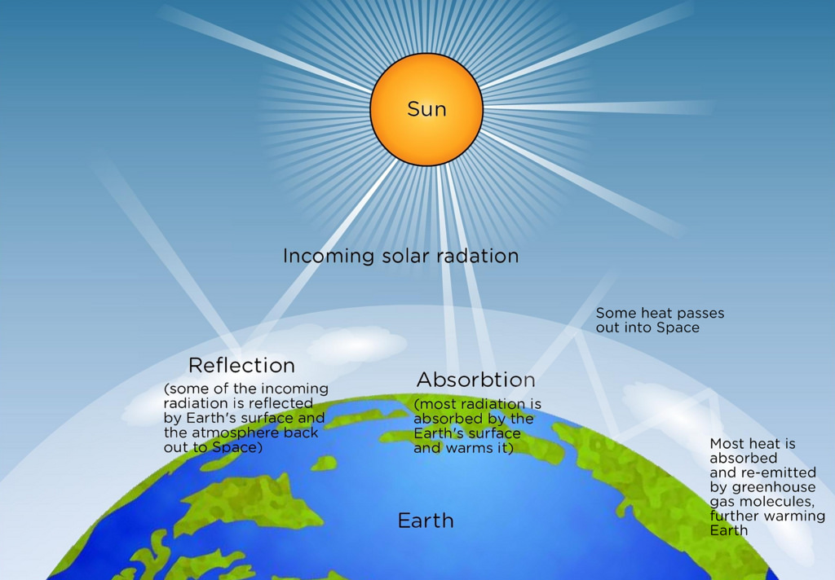
Radiation
The ultimate source of energy that drives the atmosphere comes from the sun.
Radiation from the sun moves through the earth/atmosphere/ocean system producing the weather and climate we know.

Slide 3
Radiation
Understanding radiation can explain many interesting questions, such as:
  Why do temperatures cool more on clear nights?
  Why can CO₂ warm the earth?
  What is the greenhouse effect?

Slide 4
Definition
Radiation: the process whereby energy is transferred through space without the need for an intervening medium.
Radiation is transmitted by electromagnetic waves that move through a vacuum at 300,000 km per second (186,000 miles per second)
Examples; visible light, radio waves.

Slide 5
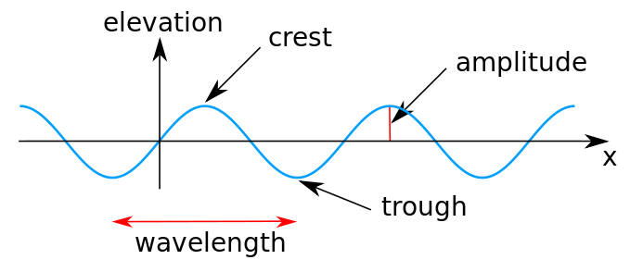
Electromagnetic Waves Vary by Wavelength
One wavelength is the distance from ridge to ridge or crest to crest

Slide 6
Electromagnetic waves range from less than a micron (UV) to hundreds of meters
This range of wavelengths is called the electromagnetic spectrum

Slide 7
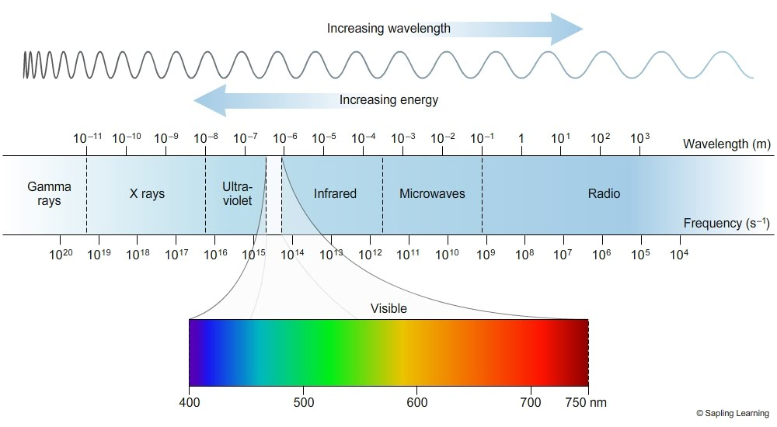
Electromagnetic Spectrum

Slide 8
All objects with T> 0 K emit radiation, although some objects are more efficient than others
The amount of radiation emitted by an object depends on temperature, with warmer objects emitting more radiation.

Slide 9
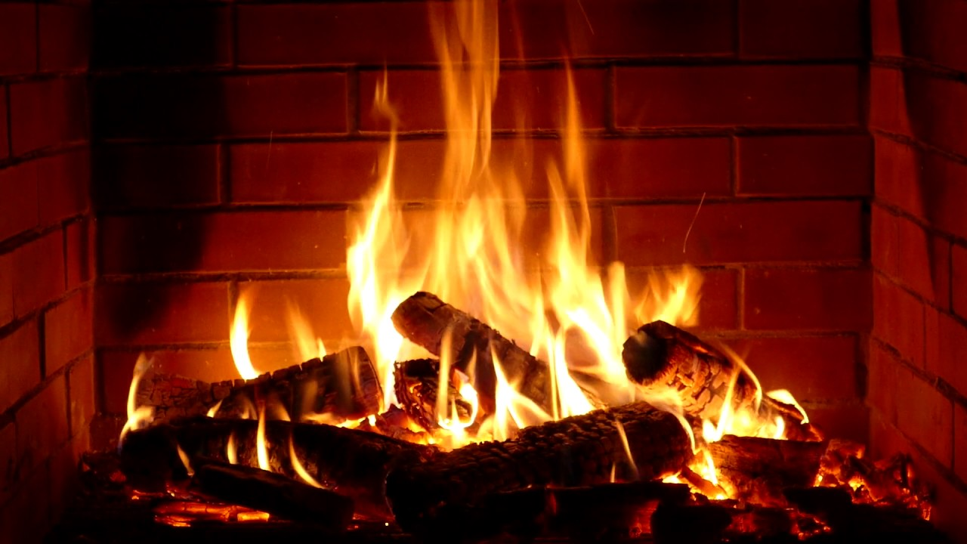
Which Shouldn’t Surprise Anyone

Slide 10
Stefan—Boltzman Law
R = cT⁴
Where R is the amount of radiation emitted per unit area for a surface of temperature T (K). C is a constant
So doubling the temperature results in 16x the radiation.

Slide 11
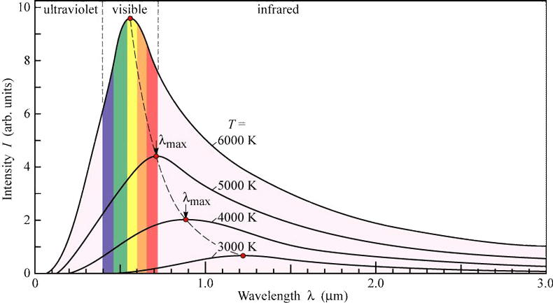
The amount of radiation emitted by an object varies by wavelength.
Characteristic shape of this variation

Slide 12
Wien’s Law
The wavelength of the peak radiation emitted by an object varies with temperature, with warmer objects having peak radiation at shorter wavelengths.
Expressed in famous Wien’s Law:
λ_{max} (μm)= 2892/T(K)
λ_{max} is the wavelength of the maximum or peak radiation

Slide 13
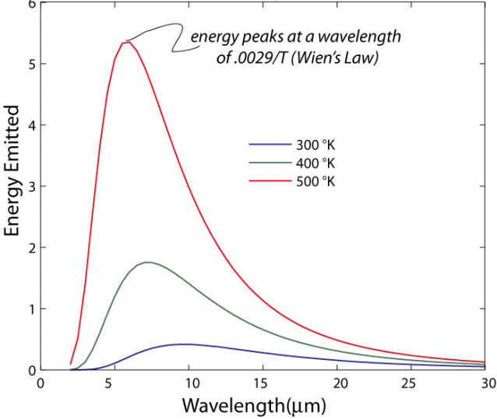

Slide 14
Wien’s Law
For the temperature typical of the earth’s surface, say 20C or 293K, λ_{max}= 9.9 microns
For the temperature of the sun’s surface (T~6000K), λ_{max} =~.5 microns

Slide 15
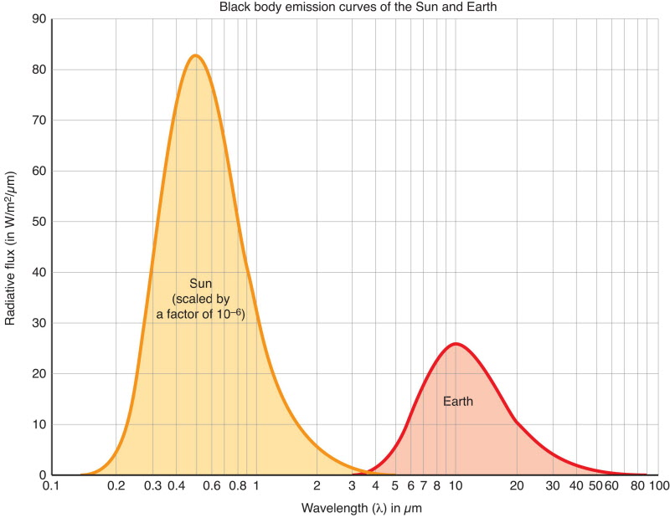
Earth Versus Sun Emission

Slide 16
To summarize
Warmer objects emit more radiation
Warmer objects emit their maximum radiation at shorter wavelengths.

Slide 17
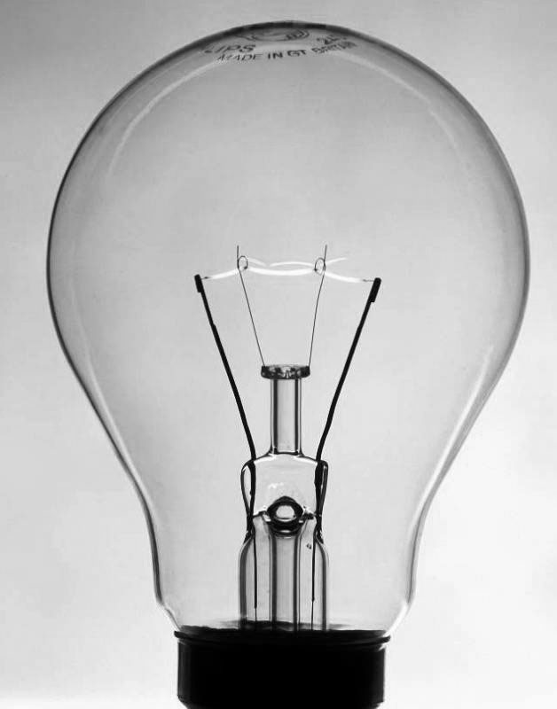
What about lightbulbs?
Regular lightbulbs (not LEDs) emit a lot in the visible, which means they have to be approximately the same temperature as the sun’s surface. Also called incandescent bulbs.
Typical tungsten filament has a T of ~2700K
Max not in visible, but close enough for useful light
Most of the energy in the IR…this is wasted!

Slide 18
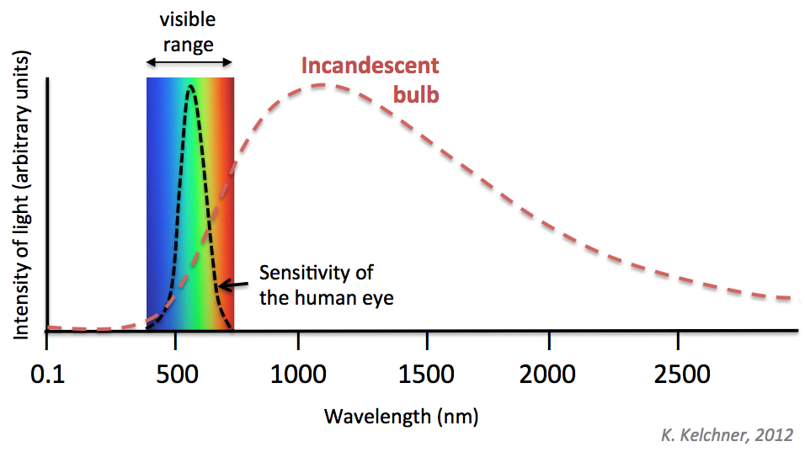
Why traditional light bulbs are inefficient
Infrared

Slide 19
Kirchoff’s Law and Black Bodies
Objects and substances can not only emit radiation, they can absorb it too!
Turns out there is a connection between the two, expressed by Kirchoff’s Law.
Kirchoff’s Law: A good emitter of radiation at some wavelength is a good absorber at that wavelength. And vice versa.

Slide 20
Kirchoff’s Law
Thus, a perfect emitter at some wavelength will be a perfect absorber at that wavelength.
If an object is a perfect absorber of radiation at some wavelength, none is reflected or scattered back,
Such an object is called a blackbody at that wavelength

Slide 21

No light reflected back.

Slide 22
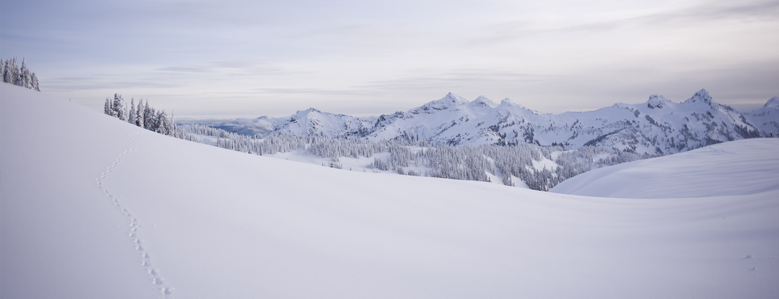
An object can be a blackbody at some wavelengths but not in others
Such behavior explains a lot of interesting phenomena.
Take snow and why it results in cold temperatures.

Slide 23
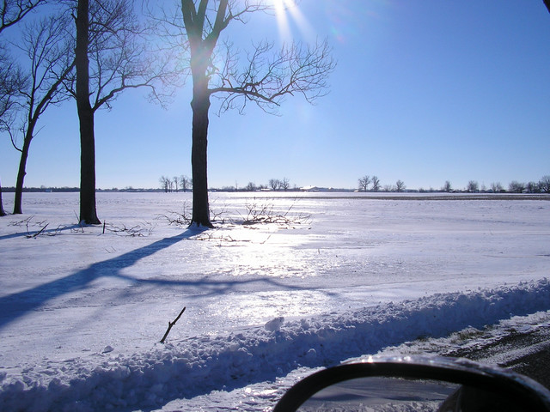
Snow
Not a blackbody (BB) in the visible (poor emitter and absorber), so reflects much of the solar radiation.
But nearly a BB in the infrared, thus a good emitter at that wavelength.
Thus, snow promotes cold temperatures and cold records.

Slide 24
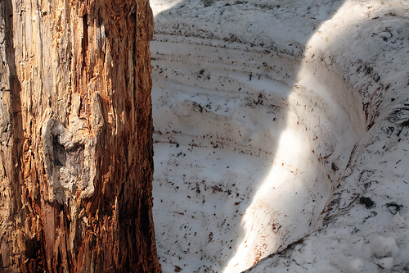
Why tree wells?

Slide 25
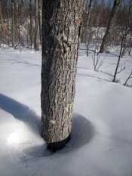
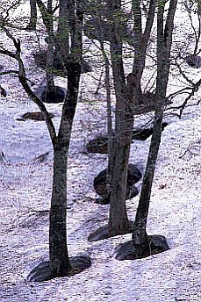
Why Tree Wells?
Snow not a BB for solar radiation. Reflects solar radiation and thus doesn’t melt much.
Snow is a BB in IR. Tree can heat up from sun and emits IR radiation that the snow can absorb

Slide 26
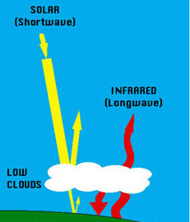
Clouds?
Not a blackbody in the visible, so reflects solar radiation considerably.
Nearly a blackbody in the infrared, so emits/absorbs in the infrared.
Big Implications: clouds cool the surface during the day (reflects solar), but warms at night (absorbs and emits infrared)

Slide 27
Snow and clouds are selective absorbers and emitters, acting like blackbodies at some wavelengths but not in others.
The same is true of many gases in the atmosphere.
This fact will be critical for you in understanding global warming

Slide 28
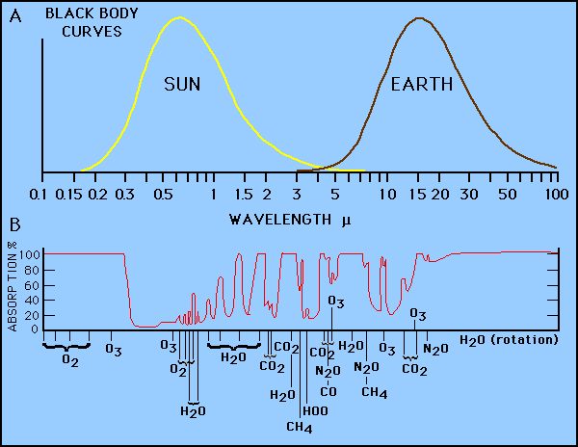
The atmosphere is relatively transparent in the visible: an atmospheric window region

Slide 29
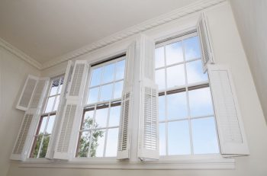

Slide 30
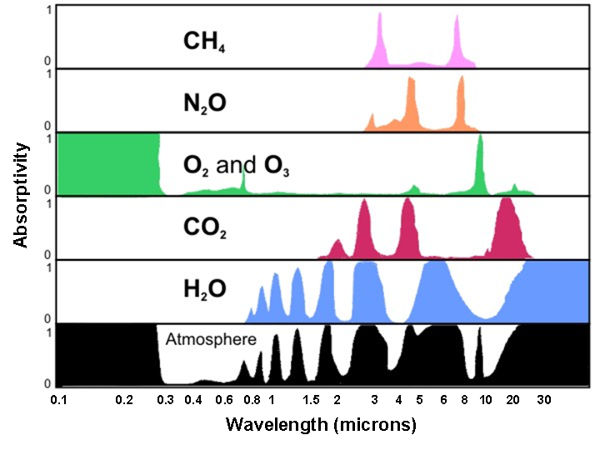
More complicated picture in the infrared (IR)
IR

Slide 31
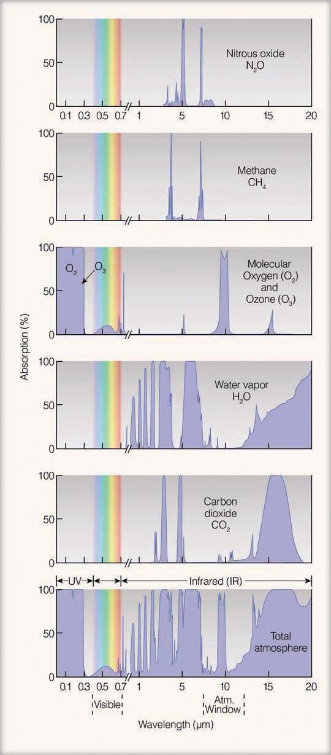
IR satellite imagery is mainly in a window region in the IR (roughly 8-12 microns)

Slide 32
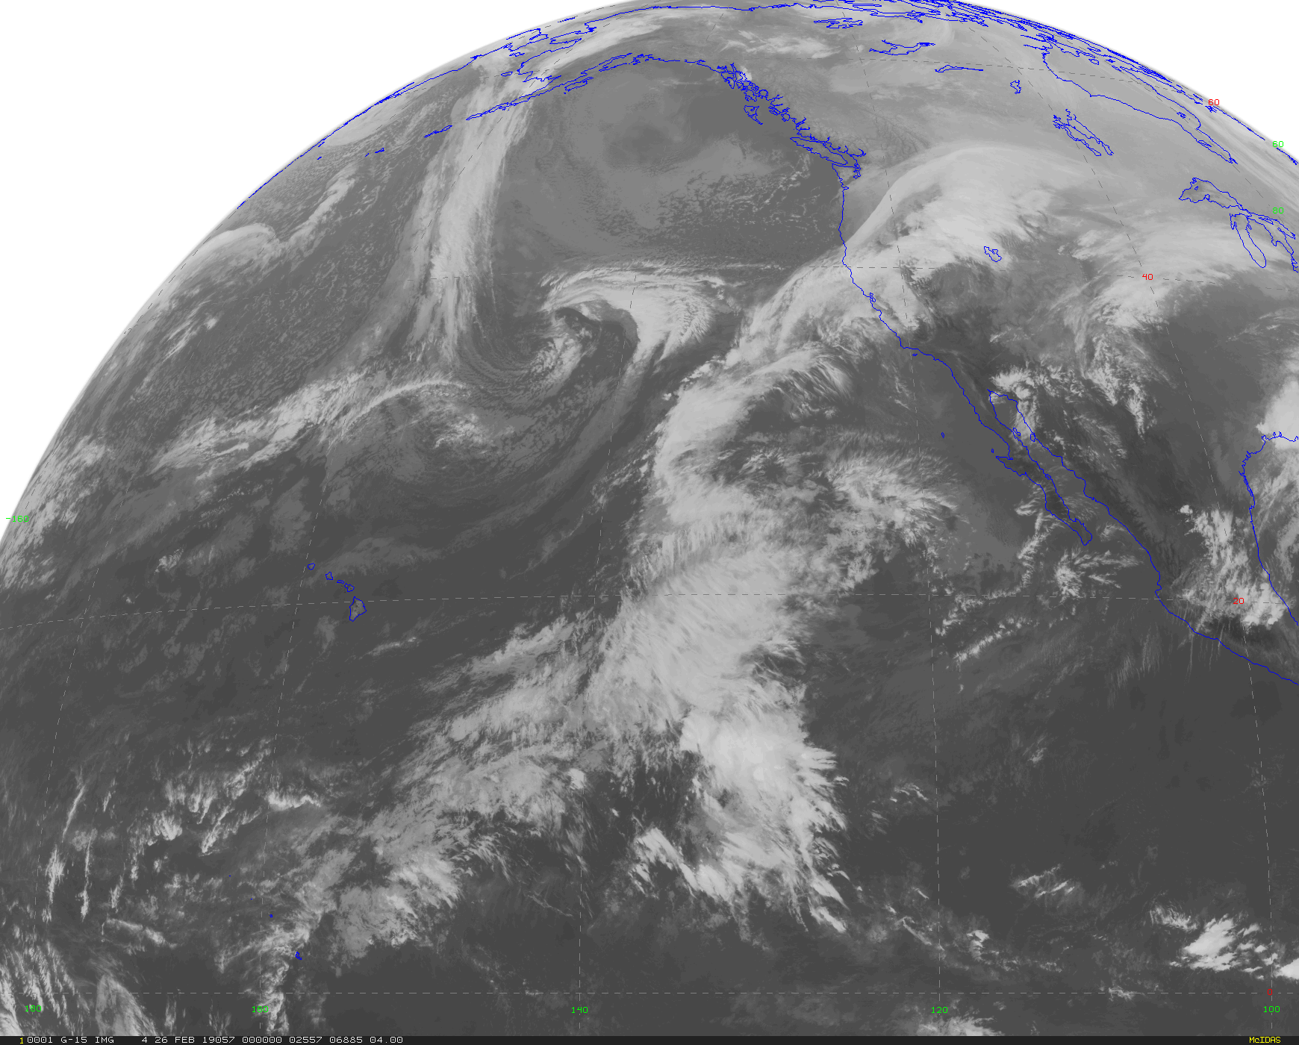

Slide 33
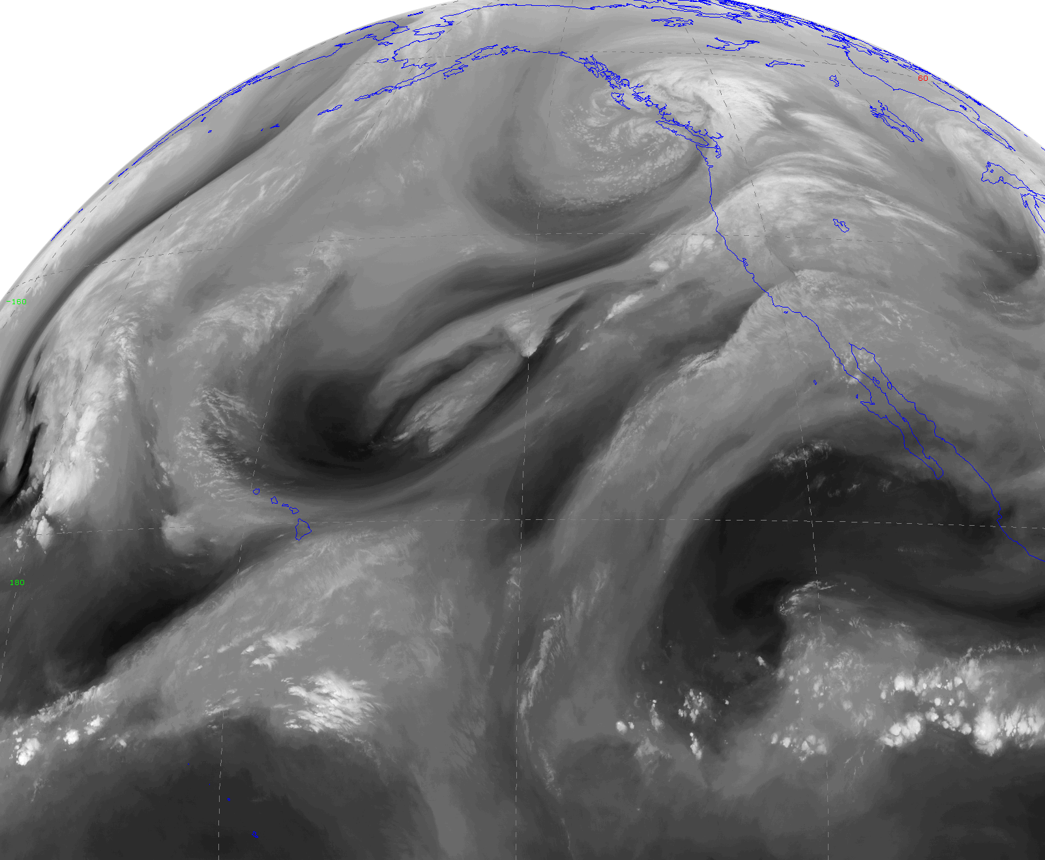
There is one satellite image that is NOT in a window region: the Water Vapor Image (6-7 micron)
Uses a wavelength
range in which water vapor is active.

Slide 34
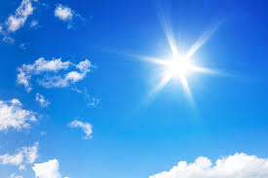
Solar Radiation

Slide 35
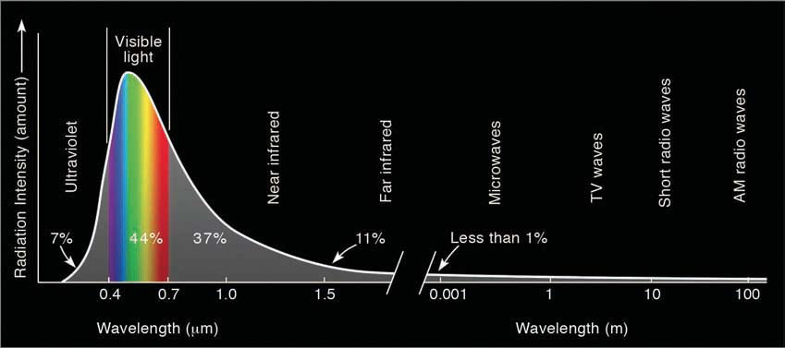
The temperature of the Sun is ~6000K and thus the max radiation is in the visible part of the spectrum (~.4-.7 microns)
Visible~44%, IR~48%

Slide 36
The solar constant
Definition: the average amount of solar radiation per unit area reaching the distance of the earth from the sun
Approximately 1366 W m⁻² (watts per meter squared)
Roughly enough energy to light 14 100-watt bulbs for every square meter.
Not exactly a constant…some small variability, particularly due to variation in sunspots (~.1% variability)

Slide 37
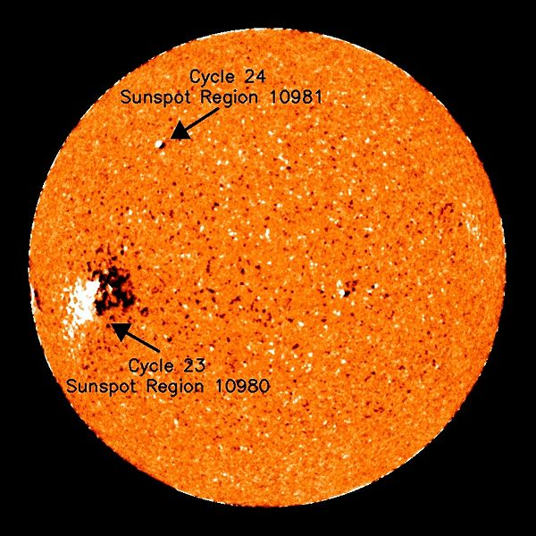
Solar emissions varies slightly due to variation in sunspots
More sunspots, more emission

Slide 38
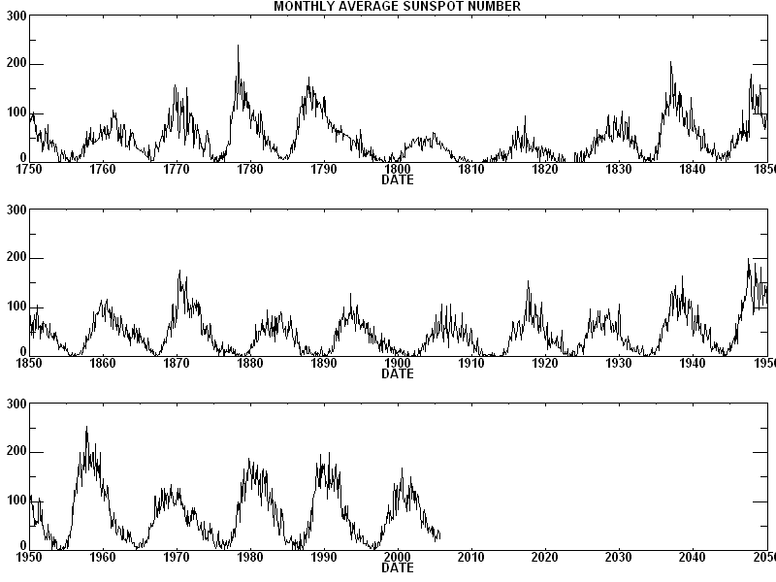
Sunspots Vary on ~ 11 year cycle

Slide 39
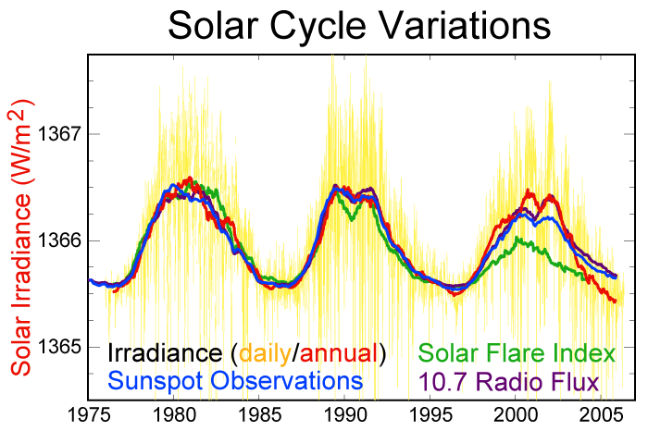
Solar radiation Varies With Sunset Cycle

Slide 40
The Amounts of Solar Radiation that reaches the top of the earths atmosphere depends on:
Latitude
Time of day
Day of year
But why?

Slide 41
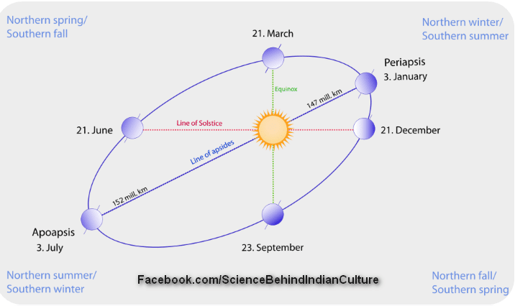
(1) Distance to the sun varies!
Earth travels in an ellipse around the sun
Earth is 5 million km closer in January than July
6.6% more intense solar radiation reaches the earth’s orbit in January than July

Slide 42
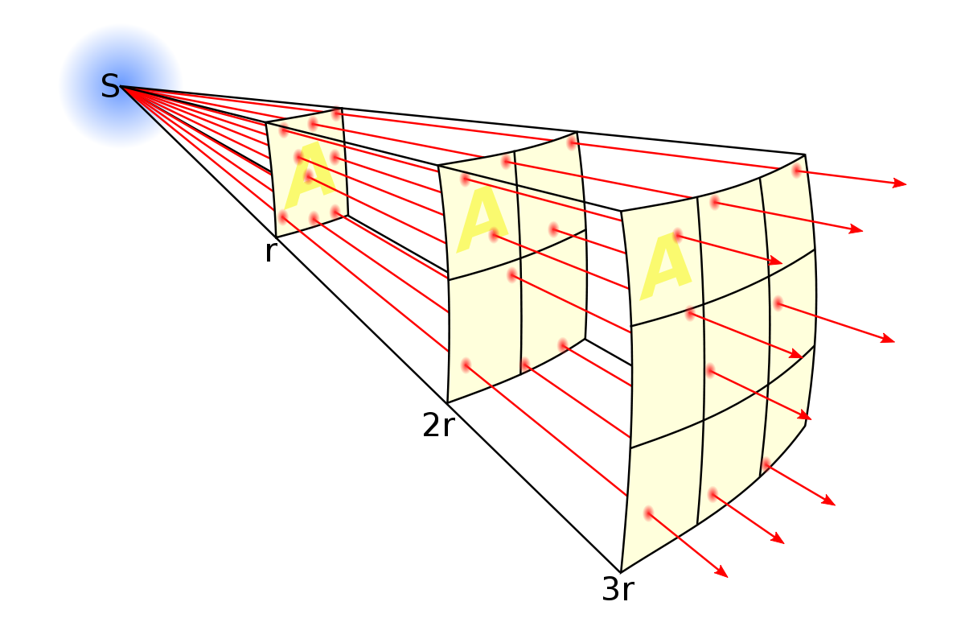
Solar Radiation Spreads Out With Distance

Slide 43
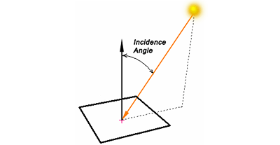
(2) Angle of incidence of the solar beam changes

Slide 44
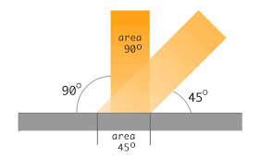
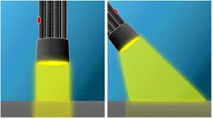
Larger angle, less intensity.
Same radiation is spread over more area and thus less intenes

Slide 45
What changes the angle of incidence and thus intensity of solar radiation?

Slide 46
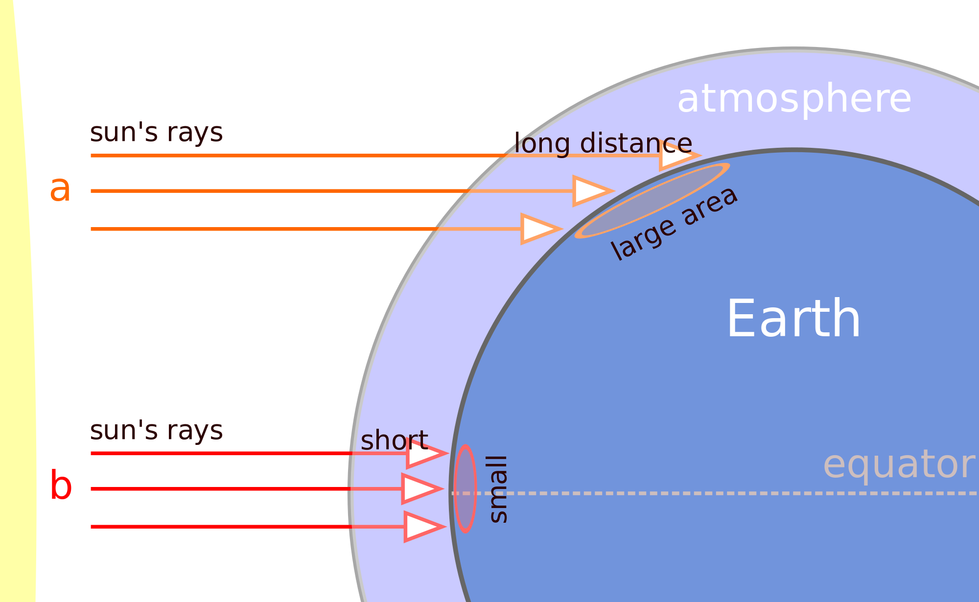
Variation in solar incidence angle caused by changes in latitude, season, time of day
Latitude

Slide 47
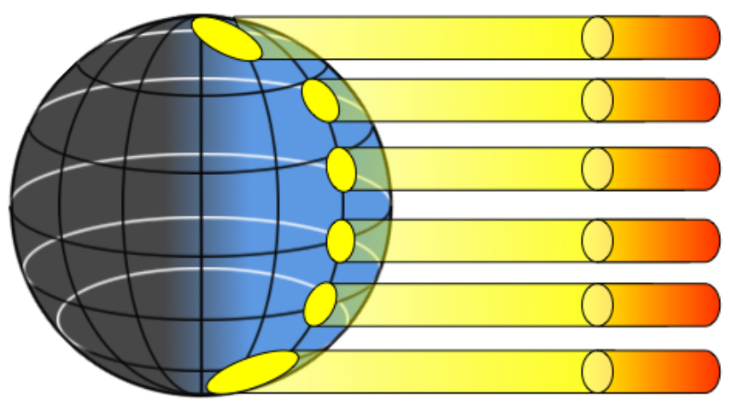
Situation at the Equinox
Weaker
Stronger

Slide 48
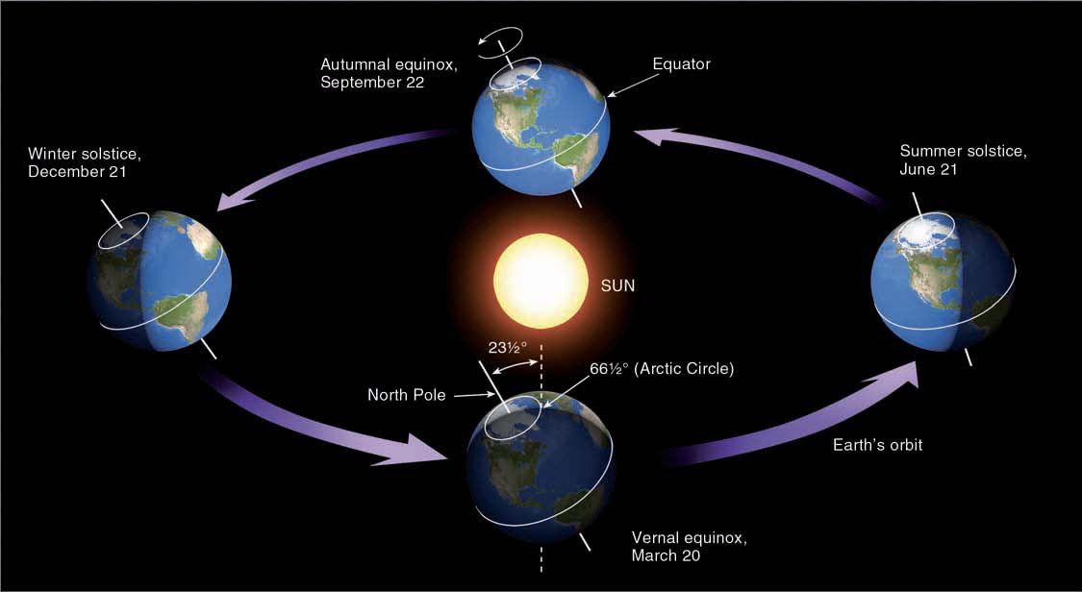
Season Changes Sun Angle and Thus Intensity

Slide 49
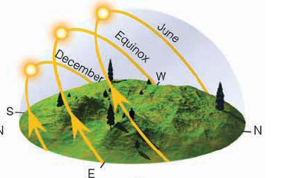
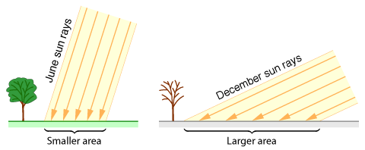
Seasonal Changes

Slide 50
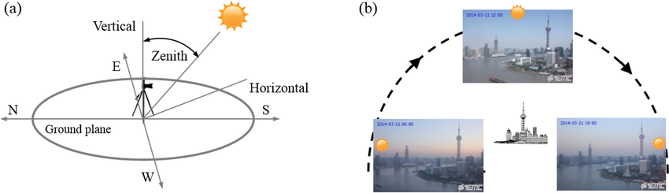
Diurnal Changes (Time of Day

Slide 51
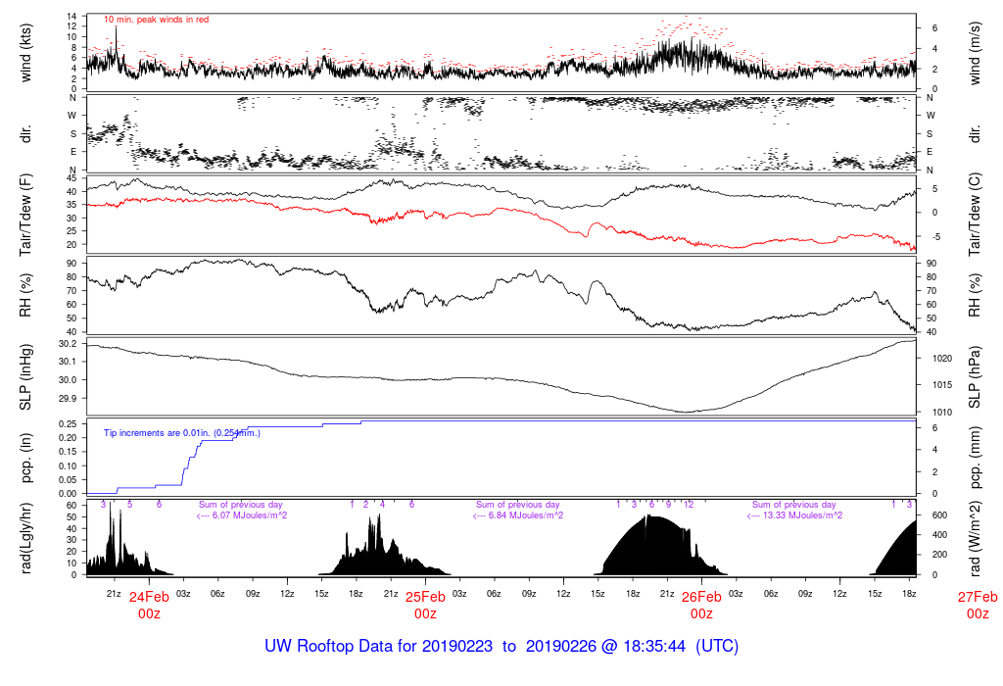

Slide 52
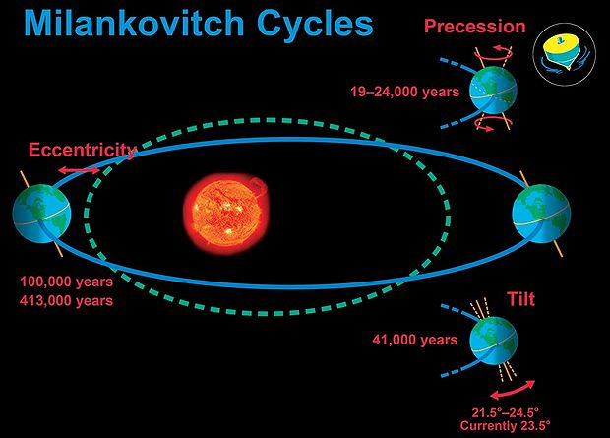
The earth’s orbital parameters change over tens of thousands of years.
Changes solar radiation and how it varies over the year. Results in ice ages and more.

Slide 53
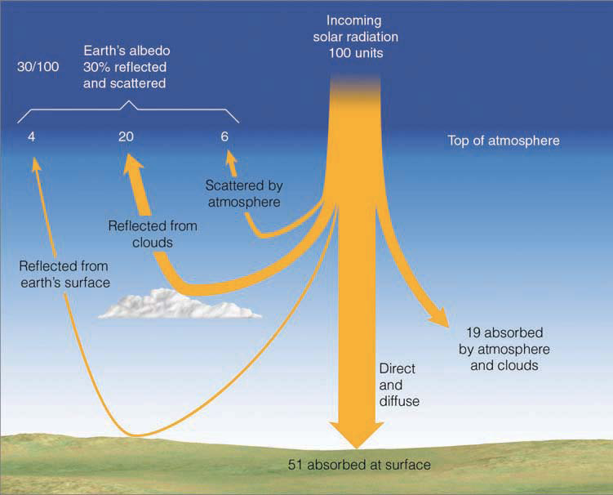
The amount of solar radiation reaching the surface is affected by the atmospheric, clouds and particles

Slide 54
So, we know what is coming in (solar radiation).
What is going out?

Slide 55
Infrared radiation (IR)!
Why? Because the earth/atmosphere is much cooler than the sun, the maximum emission is around 10 microns…in the IR

Slide 56
Infrared Radiation
Atmosphere

Slide 57
You are Now Ready to Understand The Greenhouse Effect

Slide 58
Imagine an Earth with no clouds or atmosphere.
The surface would warm until a balance developed between incoming solar and outgoing IR
solar
Infrared

Slide 59
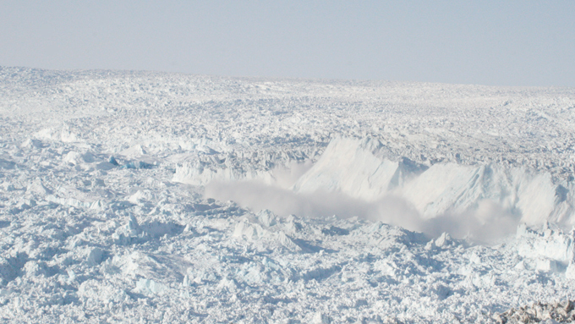
A simple calculation shows that such an Earth would end up with an average temperature of -18C (0F)
Welcome to Miami

Slide 60
But now add at atmosphere that can absorb and emit in the infrared: major changes occur!

Slide 61
Solar
Infrared
The planet will warm up until the amount coming in from the sun equals what is leaving the planet through infrared radiation. Top of atmosphere has to be effectively -18C (0F). Thus, surface must be warmer.
Atmosphere

Slide 62
The atmosphere absorbs much of the IR leaving the earth and sends a lot back down
The surface has to warm up enough to overcome this return
Atmosphere

Slide 63
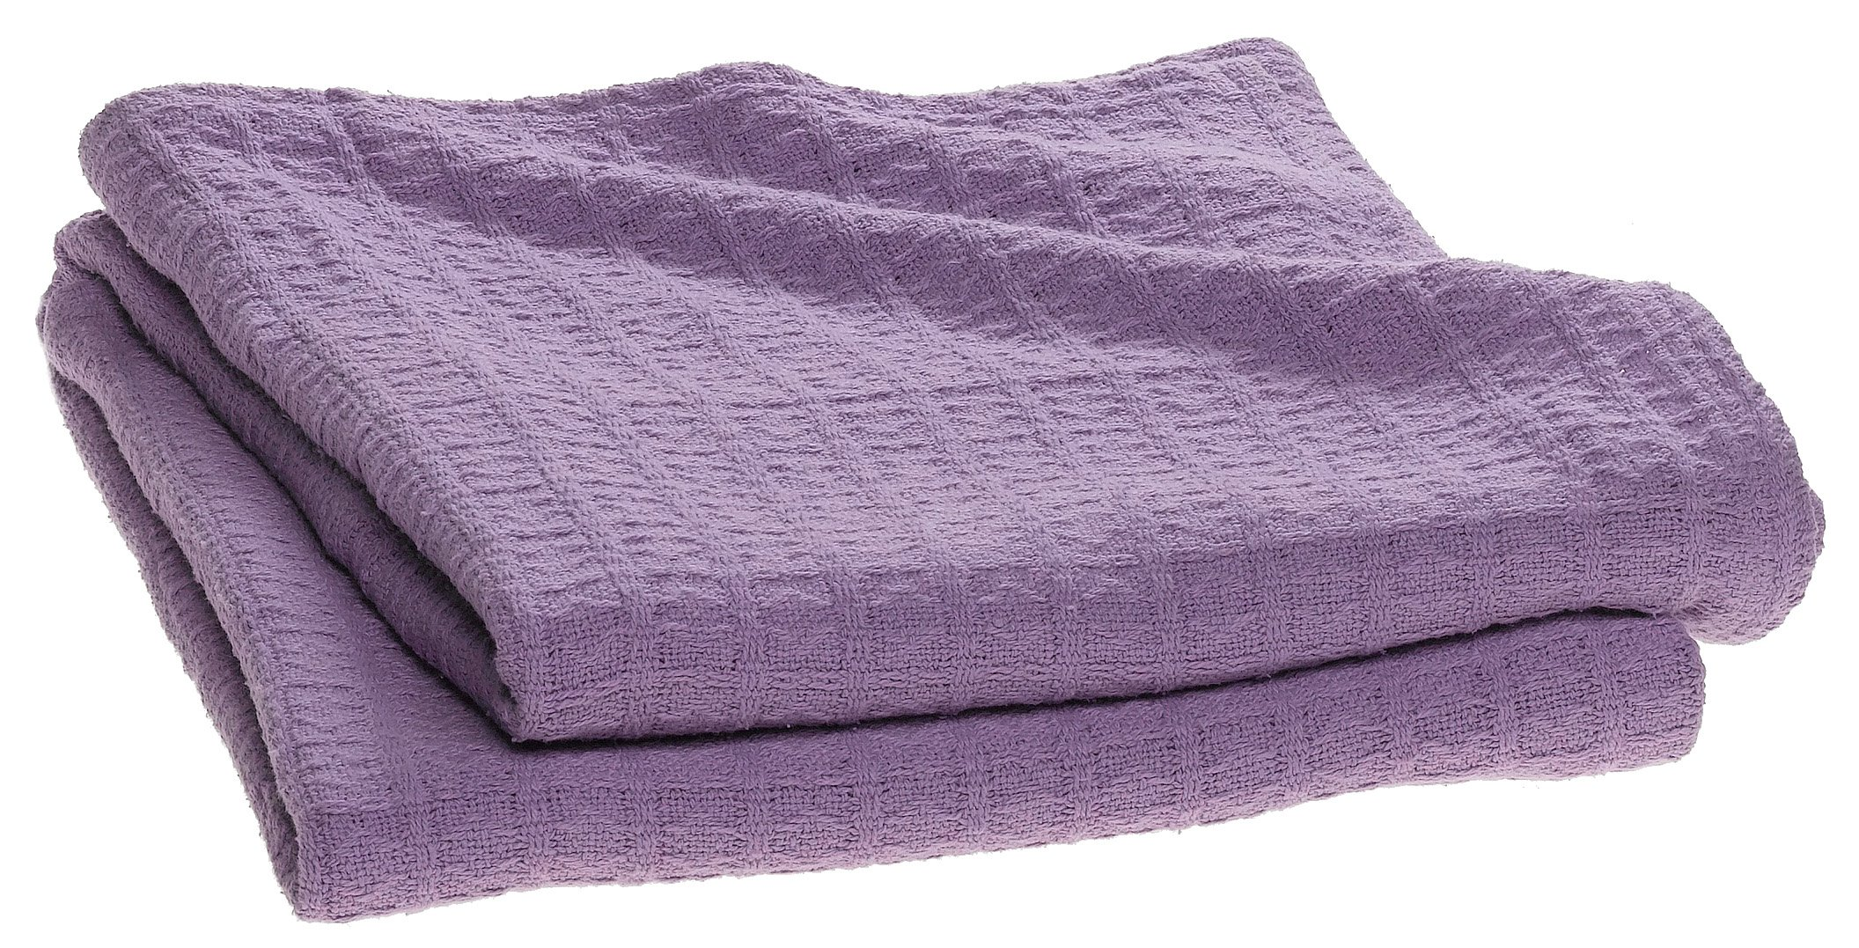
Blankets are like the atmosphere
The amount of heat transferred through the blanket depends on temperature difference across the blanket

Slide 64
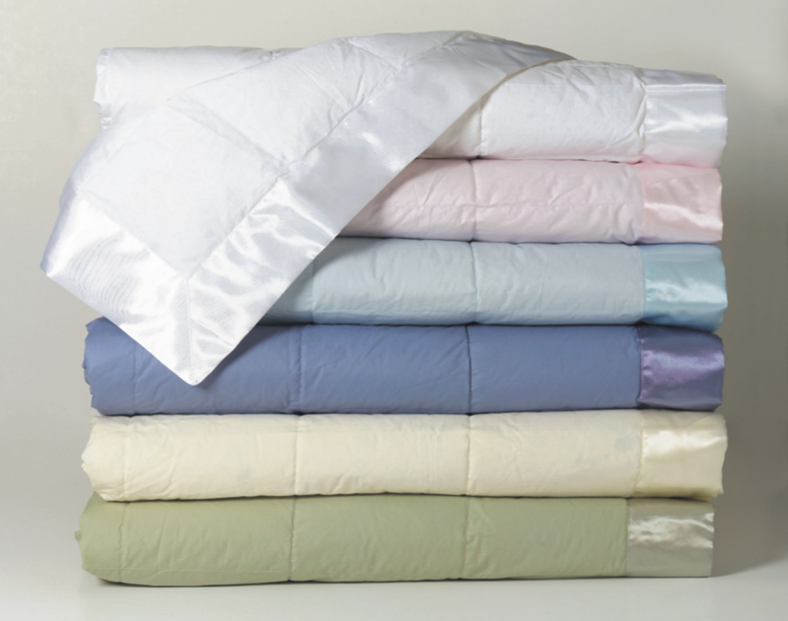
More blankets = warmer

Slide 65
With an atmosphere that is active in the infrared, the average temperature on Earth becomes 59F!
Known as the greenhouse effect

Slide 66
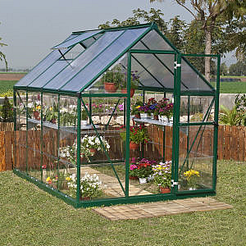
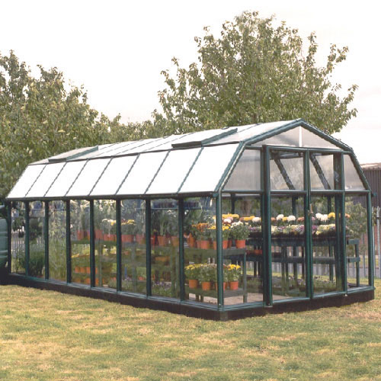
No Greenhouse Effect in Greenhouses
Better name: the atmosphere effect

Slide 67
Greenhouses
Warms by preventing warm air from mixing into atmosphere.
Glass lets solar in and IR out. Not a selective absorber like the atmosphere.

Slide 68
Greenhouse Gas
An atmospheric gas (such as carbon dioxide or methane) that absorbs infrared radiation, traps heat in the atmosphere, and thus contributes to the greenhouse effect.

Slide 69
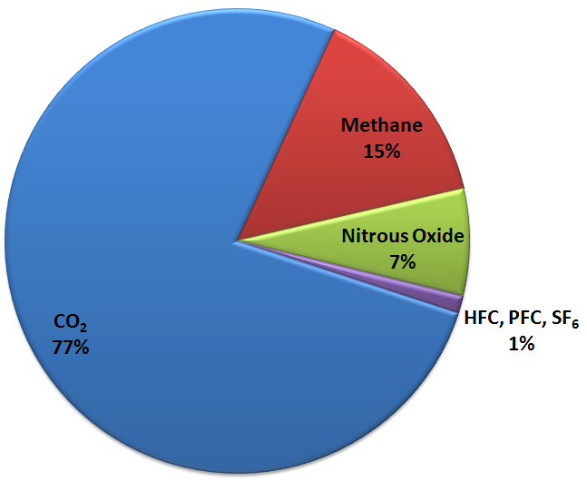
Greenhouse gases warm the planet
Carbon Dioxide
Water Vapor
Methane
Nitrous Oxide
… and others
Greenhouse Gas Emissions

Slide 70
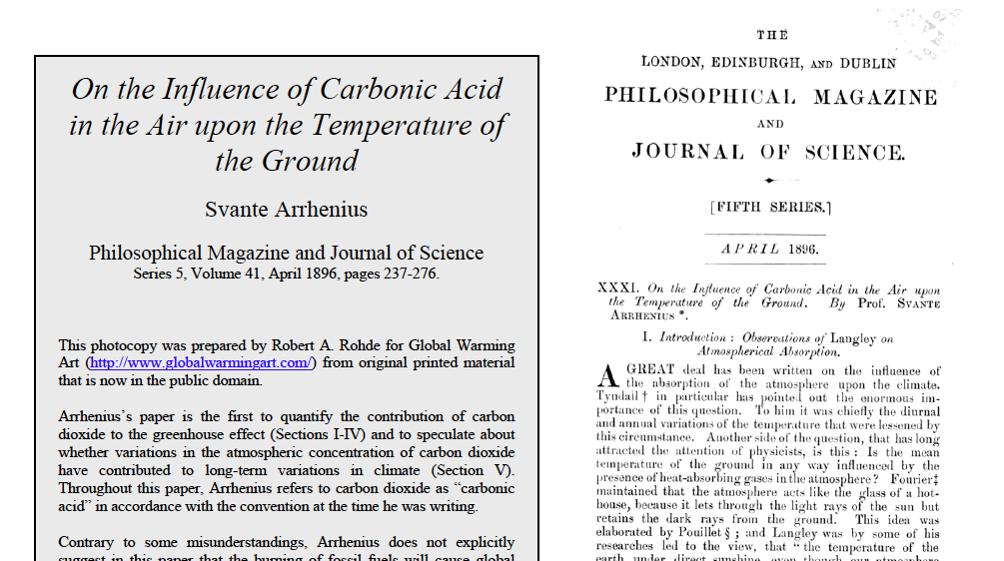
The basic physics has been known for a long time
Svante Arrhenius, 1896

Slide 71
The Issue:
Rapidly Rising Greenhouse Gases Due to Mankind

Slide 72
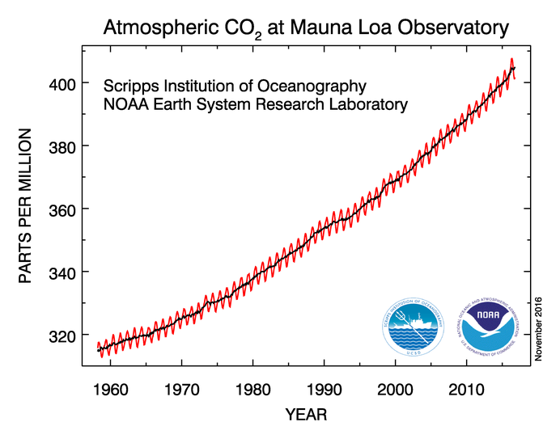

Slide 73
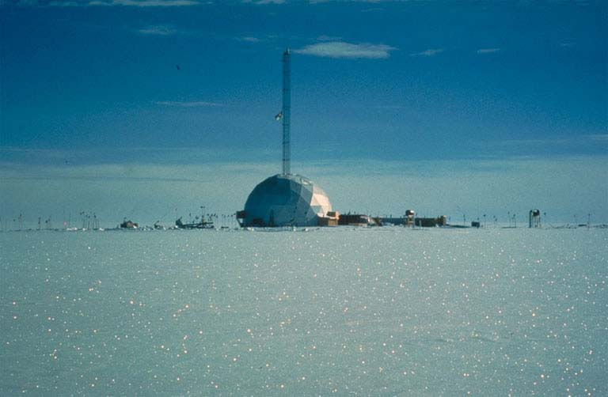
Gases Trapped in Ice Gives Us a History of the Gases in the Atmosphere

Slide 74
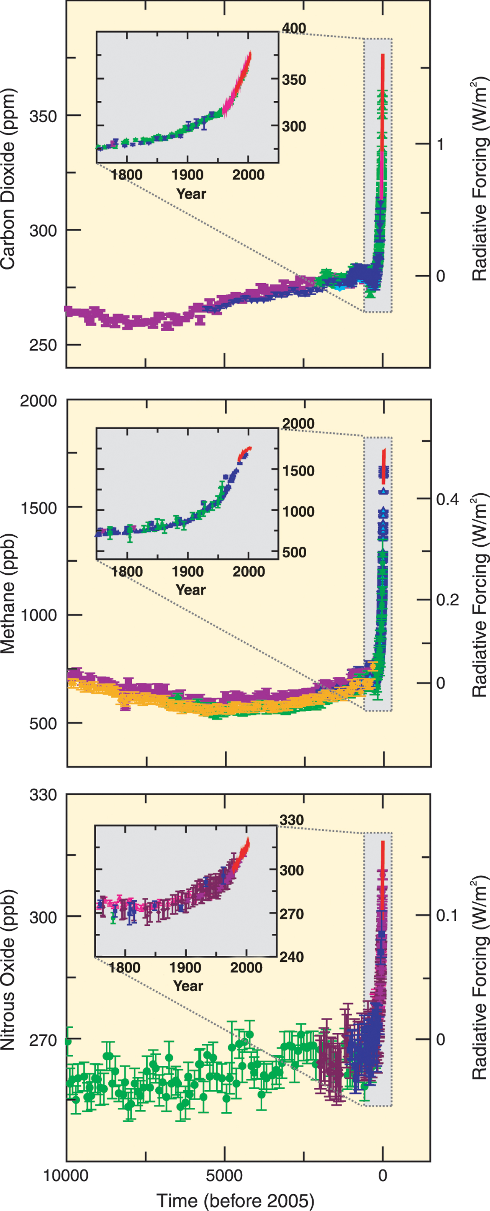
The concentrations of a variety of greenhouse gases are increasing

Slide 75

A major problem: future increases in CO2

Slide 76
But it is worse than that…
There are a number of natural “amplifiers” of mankind’s emission of greenhouse gases.
The warming due to increased carbon dioxide, methane, and other anthropogenic greenhouse gases will cause more water to be evaporated from the earth’s oceans.

Slide 77

More Water Vapor
The amount of evaporation increases with temperature.
The amount of water vapor air can contain increases rapidly with temperature
Water vapor is the most potent greenhouse gas and thus causes even MORE warming.
This is caused a positive feedback.

Slide 78

But it gets even worse…
Warming temperatures melt snow and ice.
Snow and ice help cool the planet because they reflect much of the sun’s radiation.
As the snow and ice sheets melt, less radiation is reflected to space and more is absorbed.
Thus, the earth gets warmer, which melts more snow.
Another positive feedback!

Slide 79


Slide 80
The Technology of Climate Prediction
Atmospheric scientists use complex climate prediction models…called General Circulation Models or Global Climate Models (GCMs)…to predict the future climate.
These models are similar to weather forecast models, but allow the gases in the atmosphere to change.
They also simulate the evolution of the oceans.
Known as coupled atmosphere-ocean GCMs.

Slide 81
Technology
Have to make assumptions about the future emission of greenhouse gases by mankind…a major uncertainty.
These models are imperfect and cannot exactly replicate the current climate….but they are getting better each year.

Slide 82

Technology
Use some of the largest supercomputers in the world
Today run at typical grids spacings of 100-150 km

Slide 83

Global climate models are too coarse to simulate regional effects.
Climate Model Terrain

Slide 84

Details on Current Study: GCM
What will happen to greenhouse gases in the future?
IPCC Report, 2001
IPCC Report, 2001

Slide 85

Representative Concentration Pathways (RCP)

Slide 86

Representative Concentration Pathway (RCP) Impacts

Slide 87
IPCC.AR4.2007
Notes:
FIGURE SPM-5. Solid lines are multi-model global averages of surface warming (relative to 1980-99) for the scenarios
A2, A1B and B1, shown as continuations of the 20th century simulations. Shading denotes the plus/minus one standard
deviation range of individual model annual averages. The orange line is for the experiment where concentrations were
held constant at year 2000 values. The gray bars at right indicate the best estimate (solid line within each bar) and the
likely range assessed for the six SRES marker scenarios. The assessment of the best estimate and likely ranges in the gray
bars includes the AOGCMs in the left part of the figure, as well as results from a hierarchy of independent models and
observational constraints. {Figures 10.4 and 10.29}

Slide 88

Some Warming is Guaranteed No Matter What We Do
The atmosphere has not caught up with the greenhouse gases that are in the atmosphere now.

Slide 89
Global Warming is NOT Uniform
Arctic warms up the most for a number of reasons, including the melting of sea ice.
Continents warm up more than oceans.
Eastern oceans up less than western oceans.
In general, the dry areas (e.g., the SW) will get drier and wet areas (e.g., British Columbia) will get wetter.

Slide 90

Sample Climate Model Output for 2100

Slide 91

Projections of Future Changes in Climate
Projected warming
in the 21st century
expected to be
greatest over land
and over high
northern latitudes

Slide 92

Precipitation: Subtropics Drier, Midlatitudes/Polar Regions/Equatorial Tropics Moisten
Winter
Summer
Change during this century, A2 scenario

Slide 93
Uncertainty
Considerable uncertainty regarding global temperature changes (roughly 1.5 to 4 C)
Even more uncertainty for local changes
Uncertainty has not lessened much even with decades of research.

Slide 94

GCMs don’t necessarily agree. There is uncertainty
Surface Temperature Change from 1970-2000 compared to 2070-2100

Slide 95

Considering a large ensemble of forecasts

Slide 96
Climate Change in the NW
Temperatures have warmed by about 1 F over the past 100 years.
This warming has proceeded on and off for the past century, with short-term excursions due to natural variability (e.g., the Pacific Decadal Oscillation, PDO)
There is no discernable trend in precipitation.

Slide 97

The Pacific Decadal Oscillation: A Mode of Natural Variability
More snow
Less Snow

Slide 98

Seattle Snow
Cold PDO
Phase
Warm PDO
Phase
48
70
95

Slide 99

NOAA temperature observations over the NW
Mainly Natural
Natural & Anthropogenic

Slide 100
Warming in the Northwest
It appears that there has been relatively modest human-caused warming in most of the Northwest so far.
This makes a lot of sense--our weather is controlled by the Pacific and the eastern Pacific is one of the last places that will warm significantly.
Global warming will be weaker and delayed here…but it will happen in force by the end of the century.

Slide 101

Change in Winter Surface Air Temperature (°C) for 1979-2008
-1.4
-1.2
-1.0
-0.8
-0.6
-0.4
-0.2
0.0
+0.2
+0.4
+0.6
+0.8
+1.0
+1.2
+1.4
Air Temperature Trend (1979-2005)
Notes:
101

Slide 102

Cascade snowpack hasn’t changed in the last 30 years

Slide 103
Future of the Northwest
Several groups are using very high resolution simulations forced by the global climate model predictions
Gives a view of the local implications of global warming.
Could our mountains and other local features make it worse or better?

Slide 104


Slide 105


Slide 106


Slide 107

Why banded structure of warming? Loss of snow

Slide 108

Temperature Increase will be Exponential Not Linear

Slide 109


Slide 110


Slide 111

But warming will result in more precipitation falling as rain rather than snow
Change in Snowpack from 1990 to 2090
-40%
0%
+40%

Slide 112

Advice: Don’t buy this after 2050!

Slide 113

Another issue: more extreme precipitation and flooding

Slide 114

Super Atmospheric Rivers

Slide 115

A.K.A.: Pineapple Express

Slide 116

When atmospheric rivers hit our terrain, intense precipitation falls

Slide 117
Global warming will intensify atmospheric rivers
Warmer air holds more water vapor.
Examined a large collection of climate models simulation for changes from 1970-2000 to 2070-2100 based on “business as usual” greenhouse gas emissions.
Winter-mean precipitation along the West Coast increases by 11-18% while precipitation on extreme atmospheric river days increases by 15-39% .

Slide 118

Flooding Potential Increases
Snow absorbs and helps to buffer heavy rain events.
With less snow, there will be less “protection.”
Thus, heavier rainfall could lead to greater flooding on major rivers.

Slide 119

Change in annual streamflow timing

Slide 120

Northwest Windstorms
Will there be more of them?
Will they become more intense?
The Inauguration Day Storm
1993

Slide 121

Northwest Windstorms
The answer appears to be no. No increasing trend in observations and none suggested by climate models.
UW investigated this issue for Seattle City Light

Slide 122

Number of times per year winds exceed a high-wind threshold (DJF) at Seattle for several simulations

Slide 123
Why windstorms do not intensity? Horizontal temperature gradient weakens

Slide 124

Sea Level Rise
Best estimates are 1-2 feet between 2000 and 2100, assuming continued greenhouse gas increases.

Slide 125

Sea Level Rise
From BOTH expansion of the ocean with warming
And melting of glaciers and ice sheets.
SL rise also varies depending on whether the land is rising or sinking.

Slide 126


Slide 127

Slow Rise (2 mm a year, 8 inches a century)

Slide 128

Northwest Wildfires and Climate
Recent increase in large wildfires, but the small increase in temperature does not explain it.

Slide 129

More fires in the early 20th century followed by suppression

Slide 130


Increasing Risk of Major Wildfires
Climate change is probably a small part of increasing fires.
Suppression has produce unhealthy forests with lots of fuels ready to burn.
Now
Original

Slide 131


Increasing Wildfire Risks
Huge increases of population in the urban/fire interface
Large increase of recreation use of forests.

Slide 132

Interestingly, a prime sign of human-inspired increase of CO2 in climate is the cooling of the upper atmosphere.

Slide 133

More CO2 in the upper atmosphere produces more emission to space.

Slide 134
Can We Predict Climate When We Can’t Forecast Next Week’s Weather?

Slide 135


Slide 136

In weather prediction we forecast the exact state of the atmosphere at some time in the future
Tomorrow’s high in Spokane will be 67F
It will rain tomorrow afternoon after 3 PM

Slide 137
In Climate Prediction we DON’T do this.
We predict average quantities over extended periods.
Example: the mean winter temperatures will be 3F higher over the Pacific Northwest.
MUCH easier to do.
Furthermore, the average conditions are closely controlled by the amount of radiation reaching and leaving the planet--and we can figure that out fairly well.

Slide 138
Two important points
It appears that the models are somewhat oversensitive to greenhouse gas forcing.

Slide 139

Two Points
It is very unlikely we will follow the A2 or RCP8.5 emission scenarios (the bad ones) through the century
Assumes rapid population growth, huge increases in the use of fossil fuels, no technological innovations

Slide 140
How to deal with global warming?
Radically reduce greenhouse gas emissions (by 90% or more now to avoid major impacts)
Pull CO2 out of the atmosphere (some technologies available, but need energy)
Adapt to the warming.
Geoengineering to reduce warming.

Slide 141

Geoengineering?

Slide 142
But even without human-caused greenhouse warming the earth’s climate would change

Slide 143

Milankovitch Cycles

Slide 144


Eccentricity of Earth’s Orbit
Varies over 10s of thousands of years

Slide 145


Obliquity and Precession

Slide 146

Fig. 14-12, p. 396
Notes:
Figure 14.12: The earth currently revolves around the sun while tilted on its axis by an angle of 23½°. During a period of 41,000 years, this angle of tilt ranges from about 22° to 24½°.

Slide 147


Slide 148


Slide 149

Periodic Ice Ages

Slide 150


Slide 151

Can We Stop the Next Ice Age?

Slide 152
Human-forced (anthropogenic) climate change has already affected our region
Even without any effects from increasing greenhouse gases like CO2

Slide 153

Massive Irrigation in Eastern WA

Slide 154

The result: cooling of 1-4F and higher humidity

Slide 155

Plowed fields: More Eastern WA dust storms

Slide 156

Seattle’s urban core is 2-10F warmer due to concrete and buildings

Slide 157

The End

